Slide 1

Devising an Ideal Network Slicing Ring Fencing Ratio for Cloud Energy Infrastructure
Student name: Vinay Sriram Iyer Student ID: x23203595
Notes:
The main goal of this research to devise and validate a network slicing ring fencing ratio through an iterative heuristic energy-aware non-convex equation that converges in energy consumption by speed and refined computational execution time. Against a consistent convergence criterion, the iterative heuristic energy-aware non-convex equation reported an efficiency gain of 91% in total energy consumption with cooling against a heuristic AUGMENT non-convex algorithm and Priority Selection Offloading Algorithm.
The iterative heuristic energy-aware non-convex equation is well suited for heterogeneous architectures whose workloads vary to meet user service demand modelled by network operators. With a dataset and optimisation equation that idealises energy-efficient practices, the carbon footprint of large-scale data centers incorporating aggregated architectures is significantly reduced.
Significant contributions for the increased search space in the incorporated algorithmic programs such as discretisation with increased complexity were leveraged by the supervisor, Mr Yasantha Samarawickrama. Implementing role-based IAM access with encryption of computational network resource data could be discussed as future recommendations in this project.

Slide 2
Outline
Introduction
Literature review
Methodology and Design
Evaluation
Main outcomes
Conclusions and future work

Slide 3
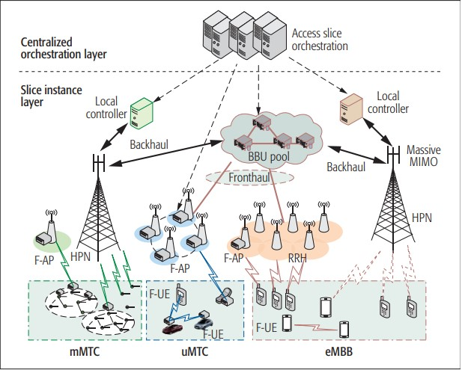
Introduction
Heterogeneous cloud topologies fail to efficiently balance the Quality of Service (QoS) requirements for varied workload resource and user centric characteristics.
An advantageous approach for cloud topologies is to ‘map’ out network resources efficiently in ‘high-quality’ network slices with improved ring fences through an iterative heuristic energy-aware non-convex equation.
The goal of benchmarking this optimisation equation is to refine convergence in energy consumption with computational execution time.
Fig 1. Centralised orchestration-based f-RAN network access slicing likened to the uneven network slicing ring fencing architecture in this project.

Slide 4
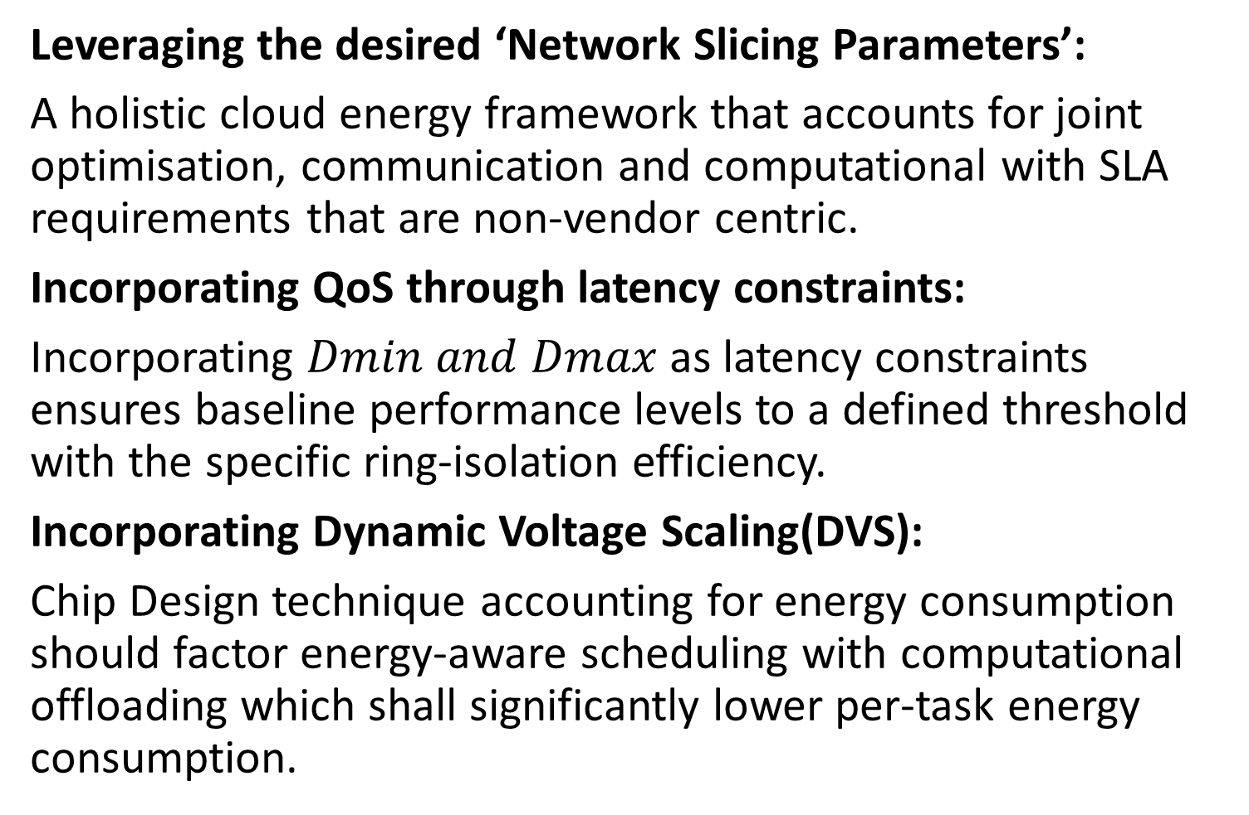
Literature review
Leveraging the desired ‘Network Slicing Parameters’:
A holistic cloud energy framework that accounts for joint optimisation, communication and computational with SLA requirements that are non-vendor centric.
Incorporating QoS through latency constraints:
Incorporating $Dmin and Dmax$ as latency constraints ensures baseline performance levels to a defined threshold with the specific ring-isolation efficiency.
Incorporating Dynamic Voltage Scaling(DVS):
Chip Design technique accounting for energy consumption should factor energy-aware scheduling with computational offloading which shall significantly lower per-task energy consumption.

Slide 5
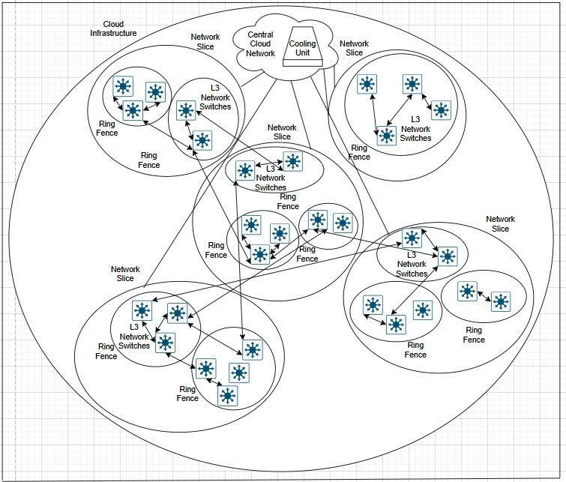

Methodology and Design
The Proposed Iterative Heuristic Energy-Aware Non-Convex Optimisation Equation:
The total energy consumption equation shall be expressed as the sum of energy consumption through the central cloud model, network slice, ring fence and network resource:
Preprocessing the GWA-T-12 Bitbrains Dataset and assessing performance with evaluating scalability through CloudSim and AWS testing.
Proposed Uneven Network Slicing Ring Fencing Architectural Diagrams for benchmarking the incorporated heuristic AUGMENT non-convex algorithm and priority selection offloading algorithm against a consistent convergence criterion.
Fig 2. Aggregated Uneven Network Slicing Ring Fencing Architecture for assessing scalability.

Slide 6
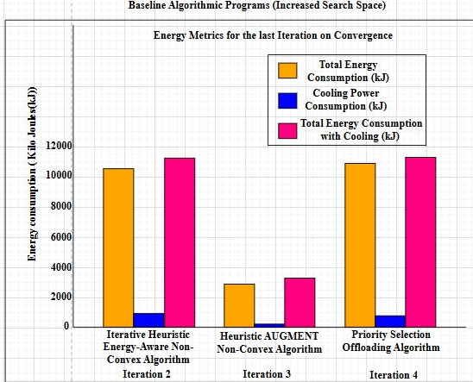
Evaluation
Conducted three experimental tests on the basis of optimising the network slicing ring to fencing ratio to idealise the iterative heuristic energy-aware non-convex equation:
Experimental Outcome 1: Preprocessing ‘GWA-T-12’ Bitbrains:
preprocessed_rnd.csv reported an improved network bandwidth of 26% and 44% decrease in CPU utilisation as compared to preprocessed_fastStorage.csv.
Experimental Outcome 2: Evaluating Baseline Simulation Performance:
The iterative heuristic energy-aware non-convex algorithmic program reported a small efficiency gain of 3% in energy consumption falling within acceptable limits.
Experimental Outcome 3: Aggregating Scalability through real-world AWS Testing:
An drop from 10680 kJ to 913 kJ with an efficiency gain of 91% in energy consumption with just one iteration validated the effectiveness of the final optimisation equation.
Fig 3. Energy Metrics for the aggregated algorithmic programs through real-world AWS testing for evaluating performance.

Slide 7
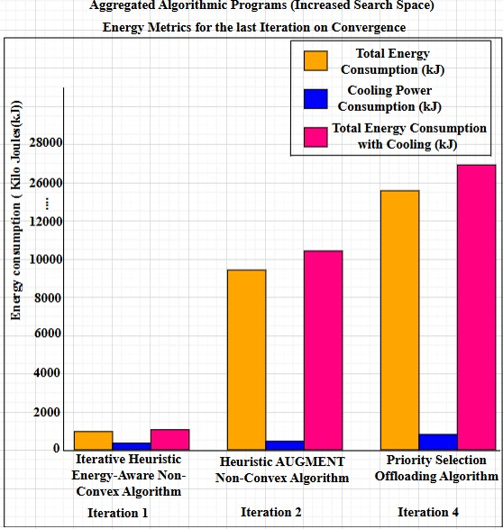
Main outcomes
The iterative heuristic energy-aware non-convex equation is most efficiently suited to model the network slicing to ring fencing ratio, meeting an efficiency gain of 3% and 91% by evaluating baseline simulation performance and assessing scalability.
The baseline heuristic AUGMENT non-convex algorithmic program reported a 76% in total energy consumption while the priority selection offloading algorithm reported 4 iterations on assessing scalability through AWS real-world testing.
Network architects can avail this optimisation equation to design distributed network topologies depending on the needs of the operator.
Fig 4. Energy Metrics for the aggregated algorithmic programs through real-world AWS testing for assessing scalability.

Slide 8
Conclusions and future work
By evaluating performance and assessing against a consistent convergence criterion, the iterative heuristic energy-aware non-convex equation was validated as a stable, optimised solution for heterogeneous architectures.
The same experimental objectives for the compared incorporated algorithmic programs might violate SLA constraints by each vendor.
Proper cost management of deployed resources through real-world testing on cloud platforms can mitigate exponential costs on large-scale organisations.
Security gaps can be addresses through least privilege access by IAM role-based access and aligning the final optimization equation on carbon footprint reduced data centers.

Slide 9
References
Abuajwa, O. and Mitani, S. (2024). Dynamic resource allocation for energy-efficient downlink NOMA systems in 5G networks, Heliyon 10(9).
Anajemba, J. et al. (2020). Optimal cooperative offloading scheme for energy efficient multi-access edge computation, IEEE Access 8: 53931–53941.
Auer, G. et al. (2011). How much energy is needed to run a wireless network?, IEEE Wireless Communications 18(5): 40–49.
Buzzi, S. et al. (2016). A survey of energy-efficient techniques for 5g networks and challenges ahead, IEEE Journal on Selected Areas in Communications 34(4): 697–709.
Calheiros, R. N., Ranjan, R., Beloglazov, A., Rose, C. A. F. D. and Buyya, R. (2011).CloudSim: a toolkit for modeling and simulation of cloud computing environments and evaluation of resource provisioning algorithms, Software: Practice and Experience41(1): 23–50.URL: https://doi.org/10.1002/spe.995
Chien, H.-T. et al. (2020). End-to-end slicing with optimized communication and computing resource allocation in multi-tenant 5g systems, IEEE Transactions on Vehicular Technology 69(2): 2079–2091.
Choudhary, R. and Perinpanayagam, S. (2022). Applications of Virtual Machine Using Multi-Objective Optimization Scheduling Algorithm for Improving CPU Utilization and Energy Efficiency in Cloud Computing, Energies 15(23).
Farreras, M. et al. (2024). Generation of a network slicing dataset: The foundations for ai-based b5g resource management, Data in Brief 55: 110738.
Fehske, A. et al. (2011). The global footprint of mobile communications: The ecological and economic perspective, IEEE Communications Magazine 49(8): 55–62.
Foukas, X. et al. (2017). Network slicing in 5g: Survey and challenges, IEEE Communications Magazine 55(5): 94–100.
Hossain, M. A. and Ansari, N. (2021). Energy aware latency minimization for network slicing enabled edge computing, IEEE Transactions on Green Communications and Networking 5(4): 2150–2159.
Huang, K., Wang, Z., Zhang, H., Fan, Z., Wan, X. and Xu, Y. (2019). Energy efficient resource allocation algorithm in multi-carrier noma systems, 2019 IEEE 20th International Conference on High Performance Switching and Routing (HPSR), pp. 1–5.

Slide 10
References
Kwak, J. et al. (2017). Dynamic network slicing and resource allocation for heterogeneous wireless services, 2017 IEEE 28th Annual International Symposium on Personal, Indoor, and Mobile Radio Communications (PIMRC), IEEE, pp. 1–5.
Lorincz, J., Kukuruzovi´c, A. and Blaˇzevi´c, Z. (2024). A comprehensive overview of network slicing for improving the energy efficiency of fifth-generation networks, Sensors24(10): 3242.
Mao, Y., Zhang, J. and Letaief, K. (2016). Dynamic computation offloading for mobile-edge computing with energy harvesting devices, IEEE Journal on Selected Areas in Communications 34(12): 3590–3605.
Masoudi, M. et al. (2022). Energy-optimal end-to-end network slicing in cloud-based architecture, IEEE Open Journal of the Communications Society 3: 574–592.
Mesodiakaki, A. et al. (2021). 5G-COMPLETE: End-to-end Resource Allocation in Highly Heterogeneous Beyond 5G Networks, 2021 IEEE 4th 5G World Forum (5GWF),IEEE, pp. 412–417.
Saxena, S. and Sivalingam, K. M. (2022). Slice admission control using overbooking for enhancing provider revenue in 5g networks, NOMS 2022-2022 IEEE/IFIP Network Operations and Management Symposium, pp. 1–7.
Sriram, A. et al. (2019). Joint functional splitting and content placement for green hybrid cran, 2019 IEEE 30th Annual International Symposium on Personal, Indoor and Mobile Radio Communications (PIMRC), IEEE, pp. 1–7.
Tao, X. et al. (2017). Performance guaranteed computation offloading for mobile-edge cloud computing, IEEE Wireless Communications Letters 6(6): 774–777. Accessed: 1August 2024.URL: https://research.ebsco.com/linkprocessor/plink?id=ab850cc6-e715-3ac5-ab6e-4b657e94f6d3
Xiang, H., Zhou, W., Daneshmand, M. and Peng, M. (2017). Network slicing in fog radio access networks: Issues and challenges, IEEE Communications Magazine 55(12): 110–116.
Zhang, K. et al. (2016). Energy-efficient offloading for mobile edge computing in 5g heterogeneous networks, IEEE Access 4: 5896–5907.
Zhang, W., Kosta, S. and Mogensen, P. (2023). A scheduling method for tasks and services in iiot multi-cloud environments, 2023 19th International Conference on Distributed Computing in Smart Systems and the Internet of Things (DCOSS-IoT), IEEE, pp. 293–300.
Zhang, Y. et al. (2023). Joint resource allocation and task offloading for hybrid noma-assisted mec network with network slicing, 2023 25th International Conference on Advanced Communication Technology (ICACT), pp. 164–170.

